Slide 1










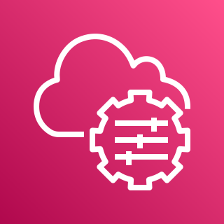


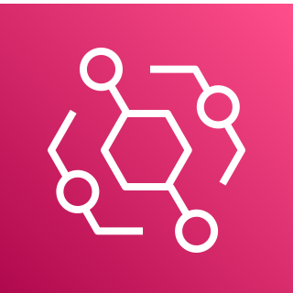
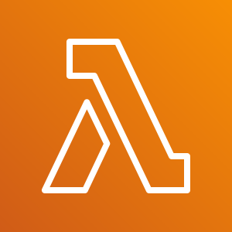

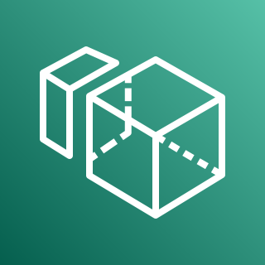
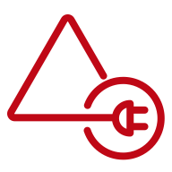

Amazon WorkSpaces Quick Start – Self-Managed AD
AWS Cloud
Region
Availability Zone 1
Availability Zone 2
AWS KMS
VPC
Internet gateway
Public subnet
Public subnet
Auto Scaling group
AWS Secrets
Manager
NAT gateway
RD Gateway
RD Gateway
NAT Gateway
AWS Systems
Manager
Private subnet
Private subnet
Application Load Balancer
Auto Scaling group
Amazon EventBridge
Domain Controller 1
RADIUS Server
RADIUS Server
Domain Controller 2
AWS Lambda
Amazon Aurora
Amazon
WorkSpaces
AD Connector
Amazon
WorkSpaces
Amazon SNS

Slide 2

Amazon WorkSpaces Quick Start – AWS Managed AD
AWS Cloud
Region
Availability Zone 1
Availability Zone 2
AWS KMS
VPC
Internet gateway
Public subnet
Public subnet
AWS Secrets
Manager
Auto Scaling group
NAT gateway
RD Gateway
RD Gateway
NAT gateway
AWS Systems
Manager
Private subnet
Private subnet
Application Load Balancer
Auto Scaling group
Amazon EventBridge
Management Instance
Amazon Aurora
RADIUS Server
RADIUS Server
AWS Lambda
Amazon
WorkSpaces
AWS Managed Microsoft AD
AWS Managed Microsoft AD
Amazon
WorkSpaces
Amazon SNS

Slide 3

Amazon WorkSpaces Quick Start – Existing Directory Service
AWS Cloud
Region
Availability Zone 1
Availability Zone 2
AWS KMS
VPC
Internet gateway
Public subnet
Public subnet
AWS Secrets
Manager
NAT gateway
NAT Gateway
Application Load Balancer
AWS Systems
Manager
Private subnet
Private subnet
Auto Scaling group
Amazon EventBridge
Domain Controller 1
RADIUS Server
RADIUS Server
Domain Controller 2
AWS Lambda
Amazon Aurora
Amazon
WorkSpaces
AWS Directory Service
Amazon
WorkSpaces
Amazon SNS

